Slide 1
Week 3: MLE of bivariate t-distribution
Ernest Chan, Ph.D.

Slide 2
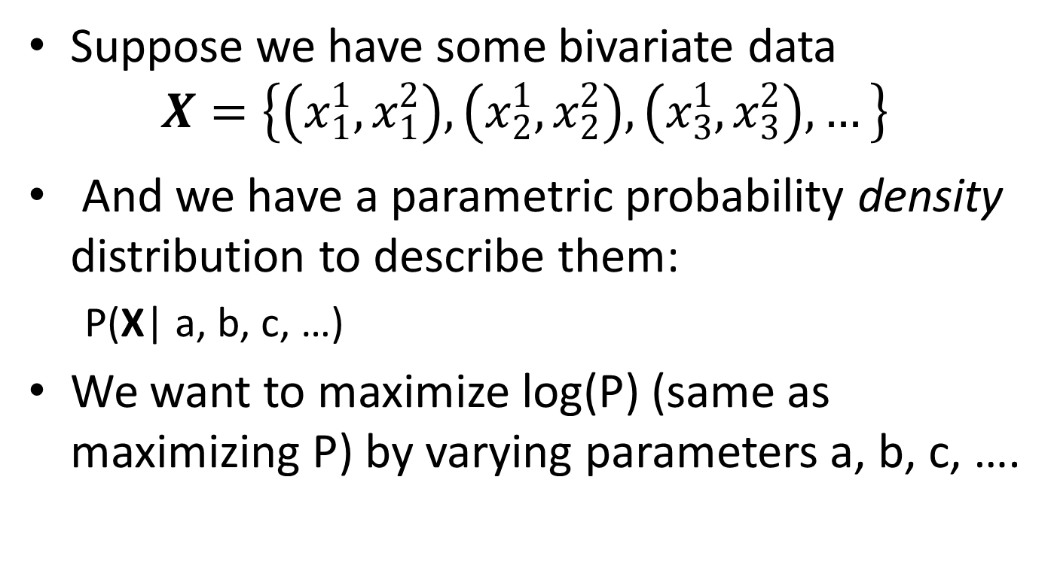
What is MLE?
Suppose we have some bivariate data
$$X=\left\{\left(x_{1}^{1},x_{1}^{2}\right), \left(x_{2}^{1},x_{2}^{2}\right),\left(x_{3}^{1},x_{3}^{2}\right),…\right\}$$
And we have a parametric probability density distribution to describe them:
P(X| a, b, c, …)
We want to maximize log(P) (same as maximizing P) by varying parameters a, b, c, ….

Slide 3
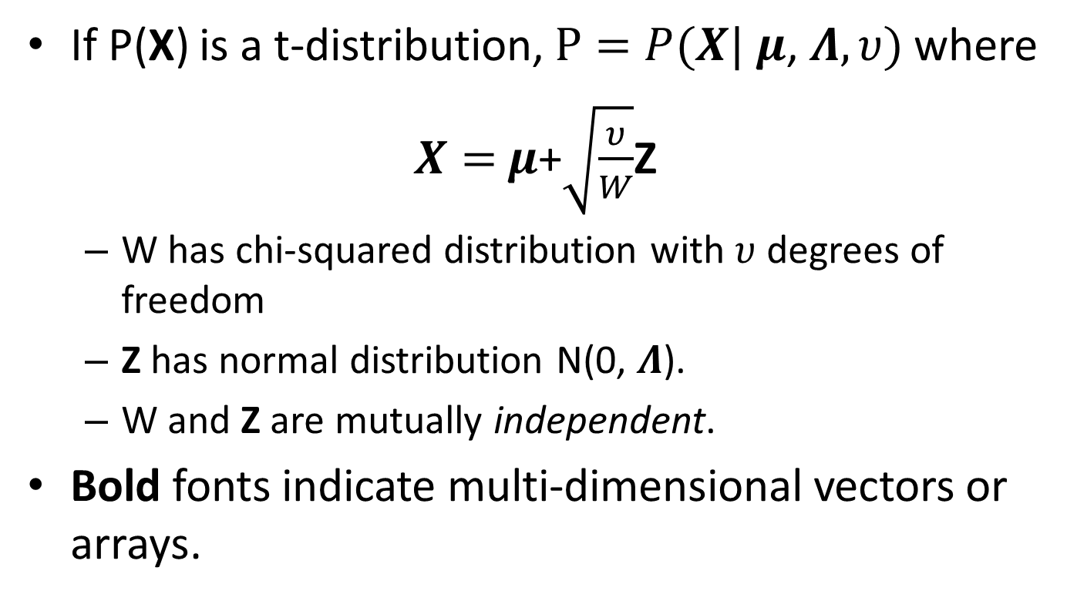
Multivariate t-distribution
If P(X) is a t-distribution, $P=P(X|$ $μ$, $Λ,υ)$ where
$X=$ $μ$+$\sqrt{\frac{υ}{W}}$Z
W has chi-squared distribution with $υ$ degrees of freedom
Z has normal distribution N(0, $Λ$).
W and Z are mutually independent.
Bold fonts indicate multi-dimensional vectors or arrays.

Slide 4
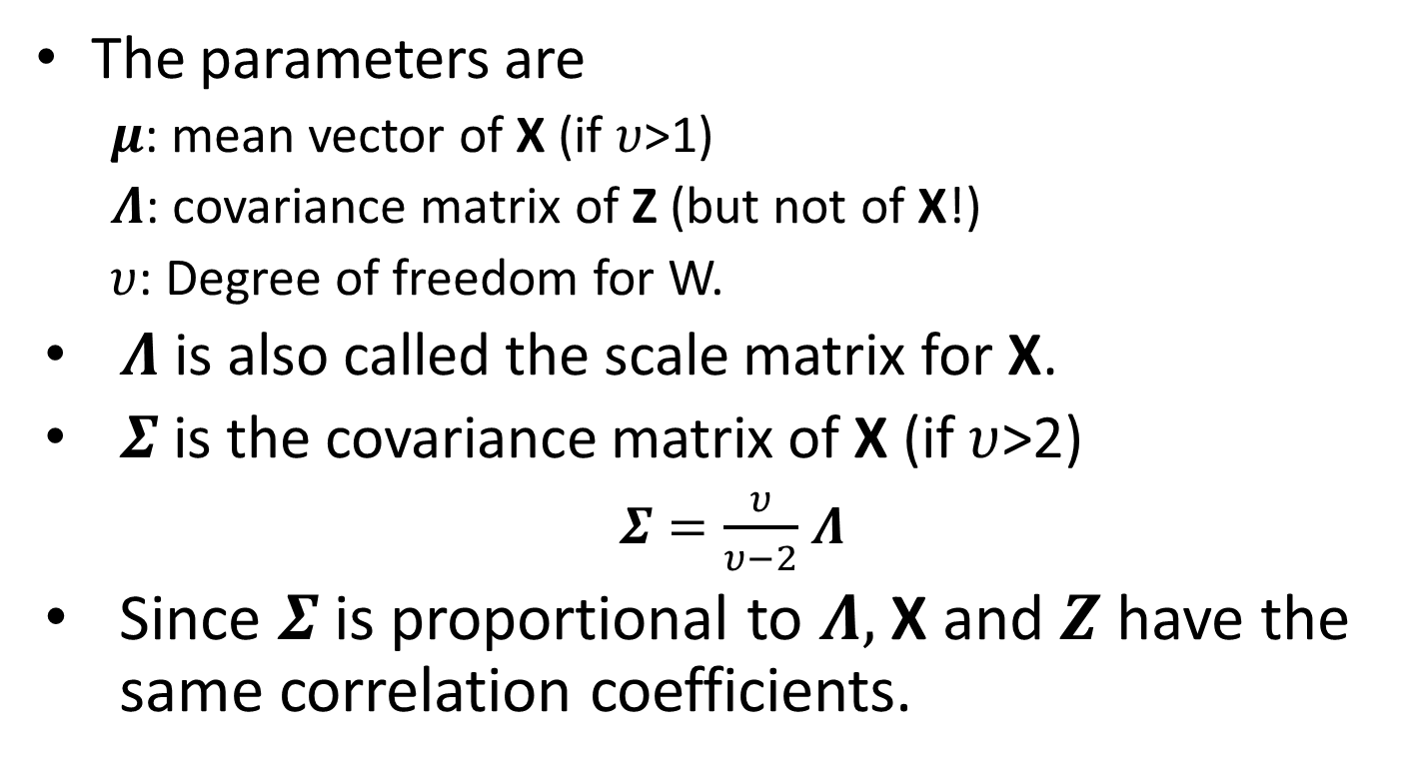
Covariance matrix of Z vs X
The parameters are
$μ$: mean vector of X (if $υ$>1)
$Λ$: covariance matrix of Z (but not of X!)
$υ$: Degree of freedom for W.
$Λ$ is also called the scale matrix for X.
$Σ$ is the covariance matrix of X (if $υ$>2)
$Σ=\frac{υ}{υ−2}$ $Λ$
Since $Σ$ is proportional to $Λ,$ X and $Z$ have the same correlation coefficients.

Slide 5
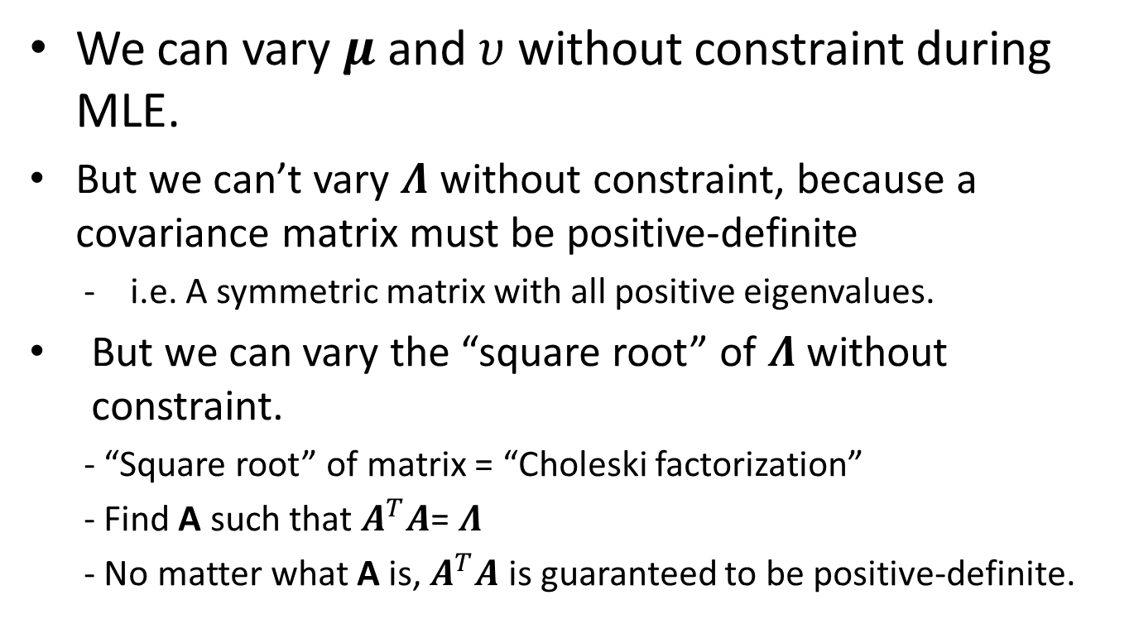
MLE of t-distribution
We can vary $μ$ and $υ$ without constraint during MLE.
But we can’t vary $Λ$ without constraint, because a covariance matrix must be positive-definite
i.e. A symmetric matrix with all positive eigenvalues.
But we can vary the “square root” of $Λ$ without constraint.
- “Square root” of matrix = “Choleski factorization”
- Find A such that $A^{T}A$= $Λ$
- No matter what A is, $A^{T}A$ is guaranteed to be positive-definite.

